Slide 1
Digital Image Processing
Lecture 9: Image Restoration II

Slide 2
Adaptive Filters
The behavior of adaptive filters changes according to the statistical characteristics of the image in the filter region.
This will enable the filters to have the desired response even if the image has regions with totally different characteristics.
Statistical characteristics considered : Local mean, local variance, local maximum, local minimum, local median, global mean, global variance and noise variance.
We study two adaptive filters:
  – Adaptive local noise reduction filter
  – Adaptive median filter

Slide 3
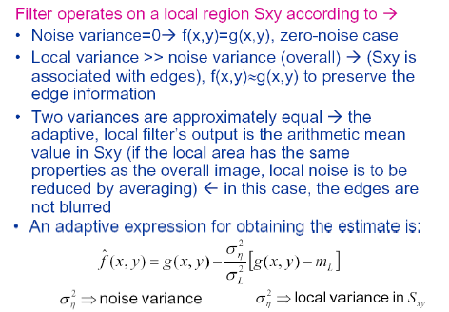
Adaptive Local Noise Reduction Filter

Slide 4
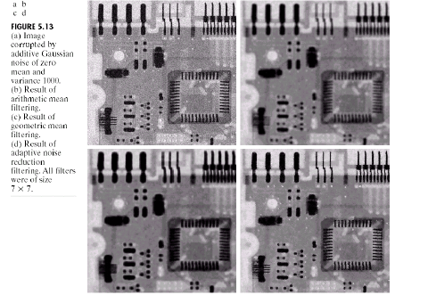
Example: Adaptive local noise reduction filter

Slide 5
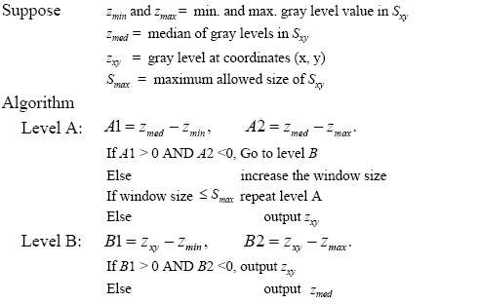
Adaptive Median Filter

Slide 6
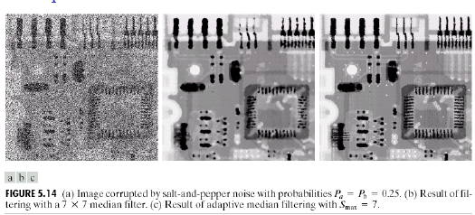
Adaptive Median Filter
Suitable for higher level of salt and pepper noise
Minimum loss of information
Example

Slide 7
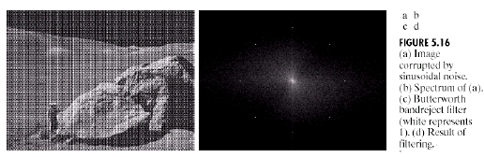

Periodic Noise Reduction by Frequency Domain Filtering
Suppose an image with periodic noise as shown
Such periodic noise can be removed using Band Reject filters in
frequency domain

Slide 8
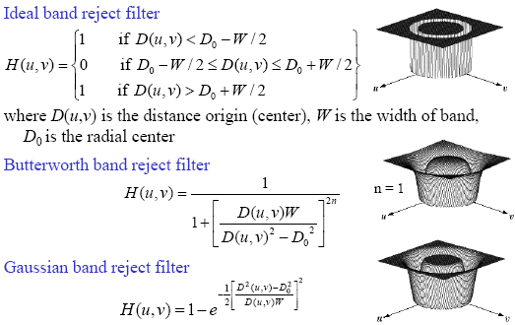
Band Reject Filters

Slide 9
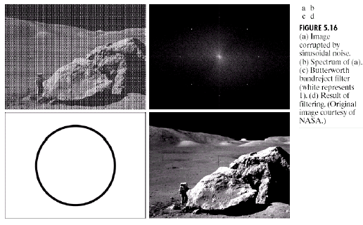
Example

Slide 10
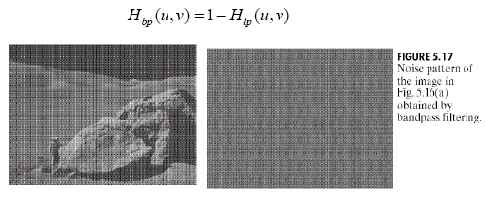
Band Pass Filters
Band Pass filters are used to isolate the noise pattern from an image (useful for noise estimation).
Band pass filters can be obtained using band reject filters:

Slide 11
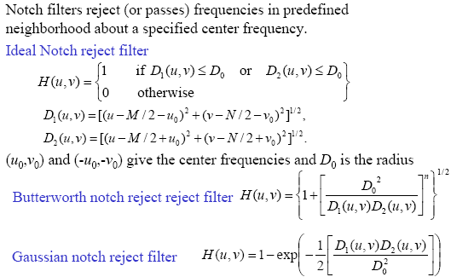
Notch Filters

Slide 12
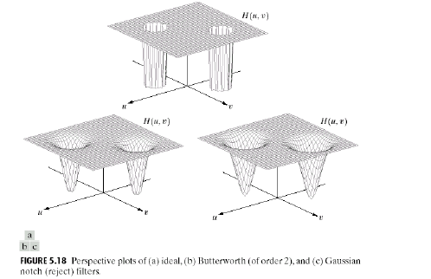
Notch Filters

Slide 13
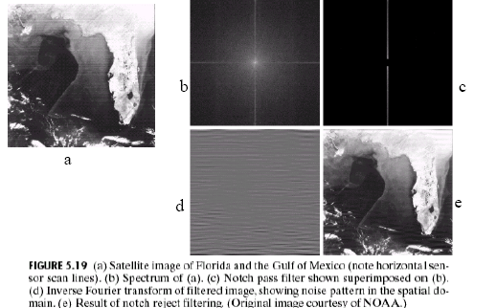
Notch Filters (Example)

